Slide 1
Welcome to Arabic
New Paltz High School

Slide 2
How do you say: I have

Slide 3
Do Now:
Make the family tree

Slide 4
She has He has

Slide 5
Translate the following:
Hello, my name is…. I am from….I am studying Arabic

Slide 6
Do you have?

Slide 7
Does she have? Does he have?

Slide 8
http://www.youtube.com/watch?v=d3OyuetNAyM
Arabic dance

Slide 9
http://www.youtube.com/watch?v=UIC4FLN5eOc
Lebanon

Slide 10
http://www.youtube.com/watch?v=JL90nZnGiQQ
Palestine

Slide 11
http://www.youtube.com/watch?v=vrFkdmw9piE
Morocco

Slide 12
http://www.youtube.com/watch?v=Q43DQmjPHh8
Persia

Slide 13
http://www.youtube.com/watch?v=SjdId-9uniI
Iraqie

Slide 14
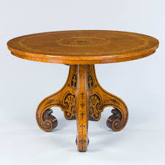
In Arabic?
Table

Slide 15
Now say my book is on the table.

Slide 16
In Arabic
Window

Slide 17
Now say, my phone is next to the window

Slide 18
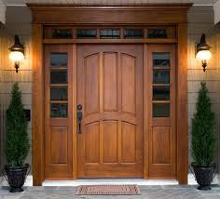
In Arabic
Door

Slide 19
Say: there is a tree next to the door

Slide 20
In Arabic
Closet

Slide 21
Say: my shirt is in the closet

Slide 22
In Arabic
Bed

Slide 23
Say: My dog is under the bed

Slide 24
In Arabic
Suite case

Slide 25
Say: my suite case is heavy.

Slide 26
Say I have a TV and it’s on the table

